Slide 1


Case Study of M/M/1 Queues with Batch Arrivals
Aline Aires Teixeira, Luiz Gustavo Barros Guedes and Masoud Khazaee
Prof. Dr. Samuel Baraldi Mafra
Junho / 2024

Slide 2
Summary
Introduction
Modeling
  Case study: two batch sizes with the same probability of
  occurrence
  Theoretical reference: conventional M/M/1
Numerical Analysis
  Flowchart
  Simulation setup
  Results
Conclusions

Slide 3
Summary
Introduction
Modeling
  Case study: two batch sizes with the same probability of
  occurrence
  Theoretical reference: conventional M/M/1
Numerical Analysis
  Flowchart
  Simulation setup
  Results
Conclusions

Slide 4
Introduction
History: Pioneering work by Erlang (1909) and Molina (1927);
Relevance: Queue systems in telecommunications, banks, restaurants, hospitals and so on;
What is the problem we are dealing with? M/M/1 queues with batch arrivals;
How can it be applied in telecommunications? When data is broadcast in bursts or bundled together in bigger units to improve efficiency;
What is the purpose of this work? Assess M/M/1 queues with batch arrivals performances under different levels of utilization and buffer sizes.

Slide 5
Summary
Introduction
Modeling
  Case study: two batch sizes with the same probability of
  occurrence
  Theoretical reference: conventional M/M/1
Numerical Analysis
  Flowchart
  Simulation setup
  Results
Conclusions

Slide 6
Modeling
Model Components:
Batch arrival rate, λ_{b};
Packet arrival rate, λ;
Service rate, μ;
Batch size (number of packets by each batch) determined by Bernoulli process;
Utilization Factor, ρ;
Buffer size, N;
Server State;
Performance metrics:
Blocking probability, mean time in system and mean packets in system.

Slide 7
Summary
Introduction
Modeling
  Case study: two batch sizes with the same probability of
  occurrence
  Theoretical reference: conventional M/M/1
Numerical Analysis
  Flowchart
  Simulation setup
  Results
Conclusions

Slide 8
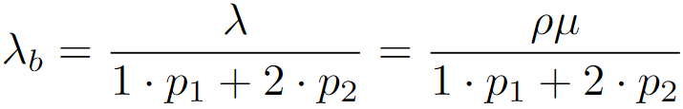
Case study: two batch sizes with the same probability of occurrence
Problem:
Consider an M/M/1 queue with batch arrivals (variable number of packets arrive at the server). The batches have different probabilities of arrival. For example, we can have a network with only two types of batches: a batch of size 1 packet, as in the M/M/1 case, and a batch of size 2 packets. In this case, the arrival probabilities of batches of sizes 1 and 2 can be equal. The arrival rate of the batches is λ_{b}. The service time has an average of 1/μ (the service is performed for each packet, not for each batch).
Determination of the batch size: Using a Bernoulli distribution;
Probabilities (p₁, p₂): For selecting one or two packet batches, respectively;
Determination of arrival rate of the batches considering different probabilities of arrival:

Slide 9
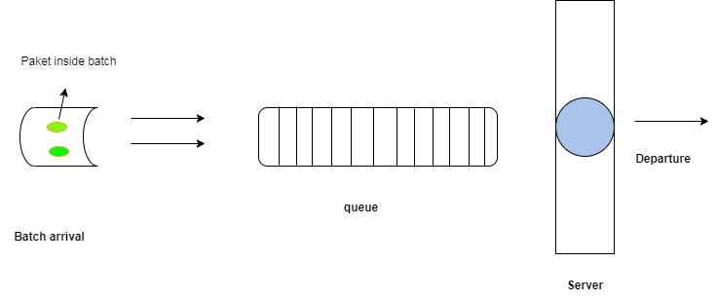
Case study: two batch sizes with the same probability of occurrence
M/M/1 queue with batch arrivals:

Slide 10
Summary
Introduction
Modeling
  Case study: two batch sizes with the same probability of
  occurrence
  Theoretical reference: conventional M/M/1
Numerical Analysis
  Flowchart
  Simulation setup
  Results
Conclusions

Slide 11
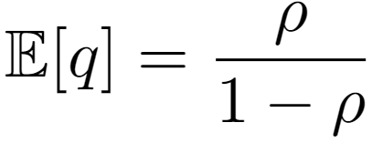
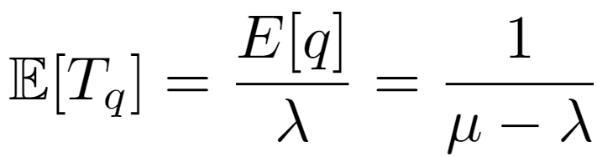
Theoretical reference: conventional M/M/1
Performance metrics
Mean packets in system:
Mean time in system:

Slide 12
Summary
Introduction
Modeling
  Case study: two batch sizes with the same probability of
  occurrence
  Theoretical reference: conventional M/M/1
Numerical Analysis
  Flowchart
  Simulation setup
  Results
Conclusions

Slide 13
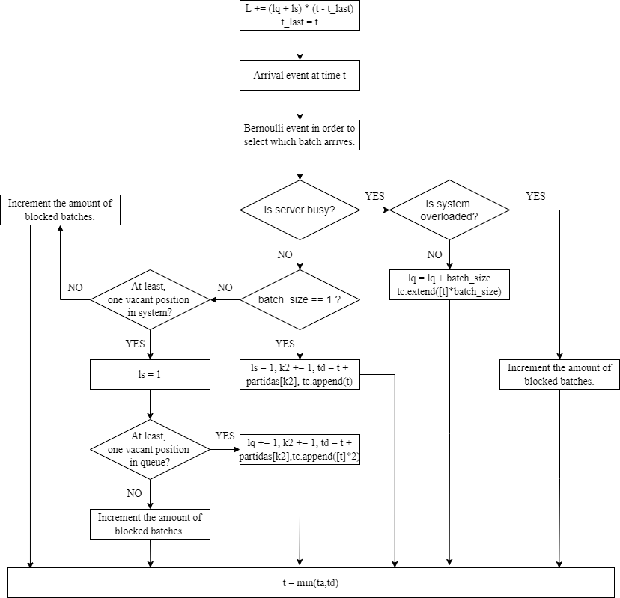
Numerical Analysis: Flowchart for Arrival Event

Slide 14
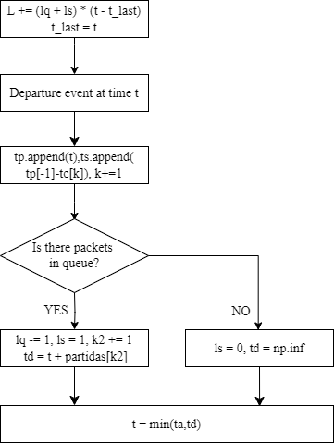
Numerical Analysis: Flowchart for Departure Event

Slide 15
Summary
Introduction
Modeling
  Case study: two batch sizes with the same probability of
  occurrence
  Theoretical reference: conventional M/M/1
Numerical Analysis
  Flowchart
  Simulation setup
  Results
Conclusions

Slide 16
Numerical Analysis: Simulation Setup
Parameters:
Service Rate, μ: 12 packets per second;
Utilization Factors, ρ: 0.2, 0.4, 0.6, 0.8, 1.0;
Simulation Time: 5000 seconds;
Buffer size, N: infinite for M/M/1 and finite (N = 10).
Performance metrics:
Average Time in System, E[q];
Average Number of Packets in System, E[T_{q}];
Blocking Probability, P_{b}.

Slide 17
Summary
Introduction
Modeling
  Case study: two batch sizes with the same probability of
  occurrence
  Theoretical reference: conventional M/M/1
Numerical Analysis
  Flowchart
  Simulation setup
  Results
Conclusions

Slide 18
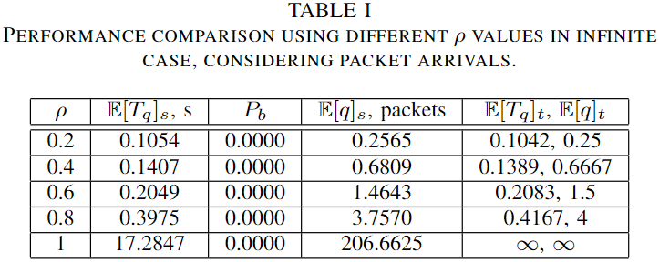
Numerical Analysis: conventional M/M/1 with infinite buffer

Slide 19
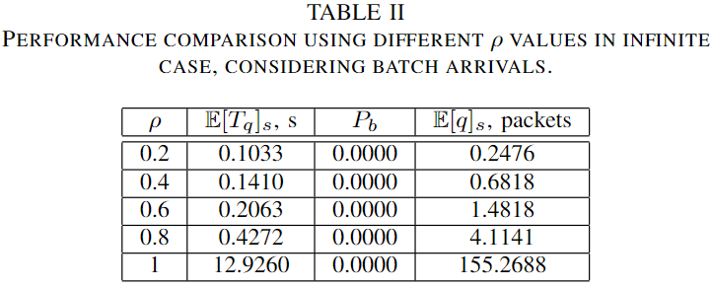
Numerical Analysis: M/M/1 with batch arrivals

Slide 20
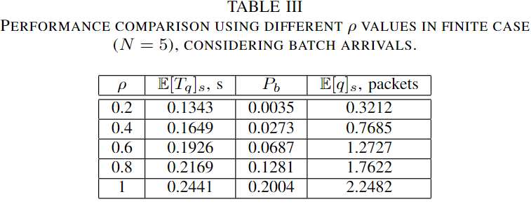
Numerical Analysis : M/M/1 with batch arrivals

Slide 21
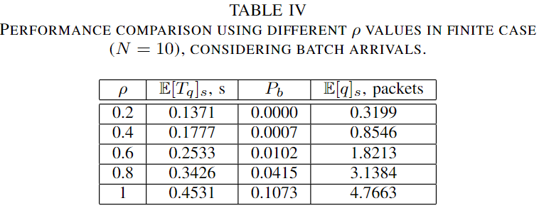
Numerical Analysis : M/M/1 with batch arrivals

Slide 22
Summary
Introduction
Modeling
  Case study: two batch sizes with the same probability of
  occurrence
  Theoretical reference: conventional M/M/1
Numerical Analysis
  Flowchart
  Simulation setup
  Results
Conclusions

Slide 23
Conclusions
O desempenho alcançado pela fila M/M/1, considerando chegadas em lotes, é o mesmo que o do sistema convencional, que analisa chegadas de pacotes. Tanto o tempo médio quanto o número de elementos no sistema consideram pacotes, não lotes, e essa é a razão. Além disso, as taxas efetivas de chegada de pacotes são as mesmas em ambas as simulações;
Baixa utilização: ocorre quando a taxa de serviço é consideravelmente maior do que a taxa de chegada. Assim, o sistema pode operar adequadamente sem rejeitar lotes ou pacotes. Se reduzirmos o tamanho do buffer, é provável que essa condição se torne limitada, aumentando a chance de bloqueio mesmo em cenários com baixa utilização;
À medida que a utilização aumenta, considera-se que a taxa de chegada aumentou para uma taxa de serviço fixa. Assim, um buffer limitado apresentará uma maior chance de rejeitar lotes, aumentando a probabilidade de bloqueio;
Trabalho futuro: Verificar expressões teóricas para análise de desempenho considerando chegadas em lotes.

Slide 24
Thanks!
luizgustavo.barros@inatel.br
masoud.khazaee@dtel.Inatel.br
aline.teixeira@dtel.Inatel.br

